Slide 1


Slide 2
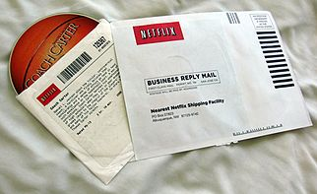
What do it do?
Netflix is a gushing content provider of VOD that enables subscribers to watch motion pictures, documentaries, tv shows and more on an extensive variety of Internet-associated gadgets.
Netflix was founded in Aug,1997 in California, USA. The founder was Reed Hasting and Marc Randolph.
The revenue of this is $11.692 billions in year 2017
They also produce Movies and Tv shows.

Slide 3
Functions
Business Development
Engineering
Global Product creation
Security
Design and Product
Content
Data Analysis
Customer Service
Marketing and Finance
Legal Process
Cost In and Out flow

Slide 4
Process
Streaming- Tie-up with production – digitalize it - share
Domestic DVD-Purchase DVD-take order online- Courier the order
Customer subscription – signup - select plan – make payments –confirmation.
Revenue and Cost
Monthly subscription fee
Advertisements
DVD or Blu-Ray Rental
Development process
Infrastructure cost
Customer Service
Cost of customer acquisition
Legal Settlements

Slide 5
Important KPI’s and Metrices
Start-up time
Buffering %
Switching between bitrates
Engagement per session
Average hours watched per user (usage)
Ratio of new, paying users to churning users (sales/retention)
Percent of users watching only Netflix content, mix of Netflix/non-Netflix content, and non-Netflix content.
Profits made in Production

Slide 6
Analysis Implemented in
Uses Big Data Analytics
Customer Satisfaction
Revenue earned
Cost incurred

Slide 7
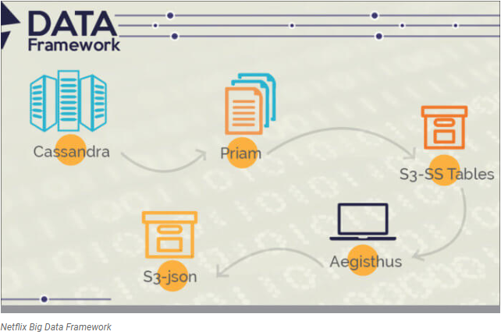
Sorted String Table (SSTable)

